Slide 1
QuBits A quantum gates simulator
1
Notes:
- Welcome everyone to this presentation -> qubits project - Here is the plan

Slide 2
PLAN
I / Introduction to quantum computing
a) How does a classical computer works?
b) How does a quantum computer differ from a classical one?
II/ The QuBits project
a) Introduction to the project
b) Quantum gates
c) Golden model and final implementation
III/ Results and conclusion
a) Comparison of results with existing works
b) Conclusion
2
Notes:
(PLAN)

Slide 3
I / a) How does a classical computer works?
Information is exchanged and saved as bits
29 = 16 + 8 + 4 + 1 = 2⁴ + 2³ + 2² + 2⁰ = 11101
3
Notes:
Information is saved and exchanged in wire as zeros and ones (0 and 5V)
Can describes numbers with binary system (unique representation and works for every number)
With numbers, anything else can be describes (ex : pixel : RGB values)

Slide 4
I / a) How does a classical computer works?
NOT
AND
OR
XOR
A | ¬A
0 | 1
1 | 0
A | B | A . B
0 | 0 | 0
0 | 1 | 0
1 | 0 | 0
1 | 1 | 1
A | B | A + B
0 | 0 | 0
0 | 1 | 1
1 | 0 | 1
1 | 1 | 1
A | B | A ^ B
0 | 0 | 0
0 | 1 | 1
1 | 0 | 1
1 | 1 | 0
4
Notes:
Bits = data // gates = a way to perform operations on this data
These gates are following the rules of the BOOL algebra
With these operations, you can do….

Slide 5
I / a) How does a classical computer works?
1-bit full adder circuit
4-bits full adder circuit
5
Notes:
You can do any basic operation. For example, here is XXX (AB =inputs, C = the carry)
Half adder => no carry => cannot chain these circuits
Full adder => can chain => can do more bits adders

Slide 6
I / b) How does a quantum computer differ from a classical one?
Bit
QuBit
Gate
QuGate
6
Notes:
Quantum computer = classical computer with quantum object (= follow the quantum mechanics rules)
Qugate : talk about it later but it works just a a normal gate : takes qubits in and give qubits out
Qubit : follow the law of quantum mechanics which means….

Slide 7
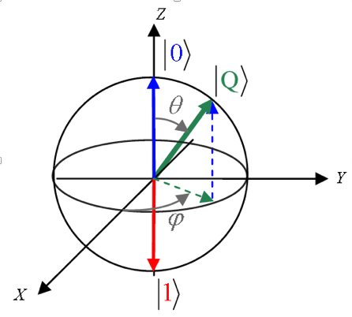
I / b) How does a quantum computer differ from a classical one?
|Q⟩ = α · |0⟩ + β · |1⟩
|α|² + |β|² = 1
7
Notes:
It can be in a superposition of states instead of being in one single state (alpha and beta proportions of zero ket and one ket) = quantum mechanic rule
Normalisation condition
Two states at the same times : can performs two times more operations. But it doesnt stop here :

Slide 8
I / b) How does a quantum computer differ from a classical one?
Number of QuBits | Number of superpositions
2 | 2² = 4 {|00⟩,|01⟩,|10⟩,|11⟩ }
3 | 2³ = 8 {|000⟩,|001⟩,|010⟩,|011⟩,|100⟩,|101⟩,|110⟩,|111⟩ }
6 | 2⁶ = 64
……. | …….
n | 2^{n}
GROWS EXPONENTIALLY!
8
Notes:
(DECRIBE THE TABLE)

Slide 9
I / b) How does a quantum computer differ from a classical one?
|Q⟩ = α · |0⟩ + β · |1⟩
MEASURMENT
α²
β²
9
Notes:
But there’s a catch!
Measurment in the quantum world means that a single state must be « chosen » (the quantum superposition collapses)
In the quantum world, measurment affects the object it measures => one single state after it (with probabilities)

Slide 10
II / a) introduction to the project
SIMULATION
Notes:
FROM quantum gates circuit TO simulated results
!! no quantum acceleration

Slide 11
II / a) Introduction to the project
GOALS :
Simulating the behavior of a QuBit
Implementing quantum gates
Comparing results
10
Notes:
Present the goals (and initial goal : understand the math behind quantum computers / quantum gates etc)

Slide 12
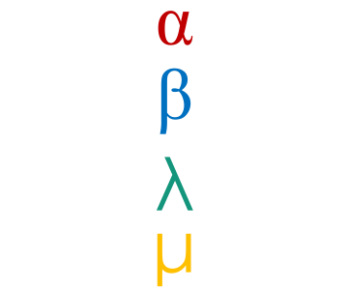

II / b) Quantum gates
|Q⟩ = α · |00⟩ + β · |01⟩ + λ · |10⟩ + μ · |11⟩
$$\left(\begin{aligned}\begin{matrix}\text{α} \\ \begin{aligned}\text{β} \\ \text{λ}\end{aligned}\end{matrix} \\ \text{μ}\end{aligned}\right)$$
$$\left(\begin{matrix}1 & 0 & 0 & 0 \\ 0 & 1 & 0 & 0 \\ 0 & 0 & 0 & 1 \\ 0 & 0 & 1 & 0\end{matrix}\right)$$
CNOT Gate :
11
Notes:
Here we have a register of two qu-bits with a superposition of 4 states
Coefficients in a vector. A qugate in then just a matrix : you mutiply the matrix and the vector, and you get the output (i’ll show how this gate works after if you want)

Slide 13



II / b) Quantum gates
$$\left(\begin{matrix} 1 & 0 \\ 0 & \text{e}\text{iΦ} \end{matrix}\right)$$
Phase Gate :
Hadamard Gate :
$$\frac{1}{√2}\left(\begin{matrix} 1 & 1 \\ 1 & \text{ -1} \end{matrix}\right)$$
$$\left(\begin{matrix}1 & 0 & 0 & 0 \\ 0 & 0 & 1 & 0 \\ 0 & 1 & 0 & 0 \\ 0 & 0 & 0 & 1\end{matrix}\right)$$
Swap Gate :
11
Notes:
Here we have a register of two qu-bits with a superposition of 4 states
Coefficients in a vector. A qugate in then just a matrix : you mutiply the matrix and the vector, and you get the output (i’ll show how this gate works after if you want)

Slide 14
II / c) Golden model and final implementation
12
Notes:
Decribe the UML diagramm (quStates inherits from quObject, Quregister is in aggregation with QuStates)

Slide 15
II / c) Golden model and final implementation
Compiled programming language
Syntax very close to Ruby’s
Much better performances
Small language that compiles into Javascript
Syntactic sugar for Javascript
Javascript is an interpreted web programming language
13
Notes:
Two implementation : golden model (goal : get it working fast, with a clear syntax and a simple language if possible)
Final implementation(goal : speed, performances, but still had the chance to keep a good / high level language)

Slide 16
III / a) Comparison of results with existing works
14
Notes:
3.7 times slower ONLY on average!

Slide 17
III / a) Comparison of results with existing works
15
Notes:
24.2 times faster on average!!

Slide 18
III / b) Conclusion
16

